Slide 1

E-COMMERCE WEBSITE

Slide 2
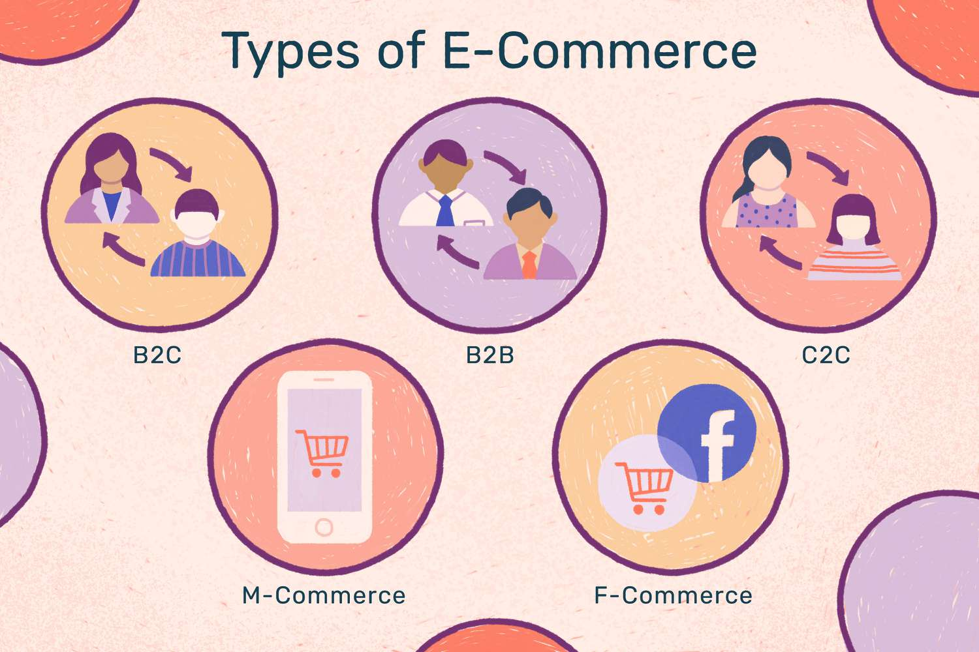
WHAT IS E-COMMERCE ?
E-commerce,also known as electronic commerce or internet commerce,refers to the buying and selling of goods or services using the internet,and the transfer of money and data to execute these transactions.E-commerce is often used to refer to the sale of physical products online,but it can also describe any kind of commercial transaction that is facilitated through the internet.
These business transactions occur either as business-to-business (B2B), business-to-consumer (B2C), consumer-to-consumer or consumer-to-business.

Slide 3
WHY USE E-COMMERCE ?
With the ever increasing use of the internet and its popularity among all demographic segments, electronic commerce is by all means the way to go for virtually all businesses.
Ecommerce has helped businesses improve their efficiency through streamlining the production and service delivery processes.
Through their websites and online advertisements, businesses can communicate with their clients, provide information on new products which enables the customer to choose among a wide range of products and services.

Slide 4
PROBLEM STATEMENT
Nowadays people are mostly busy with their hectic schedule, so it gets tough to keep track of their appointmens, deadlines or remembering their known one's birthdays, projects and more!
So our printable calendar templates are here to help them keep track without missing out on major events.

Slide 5
EXISTING SOLUTIONS
ETSY
Etsy is an online marketplace that connects sellers with buyers. It is primarily used for selling vintage items, handmade goods, art, and crafts. To sell on Etsy, you must create an account before you can open a storefront. Etsy charges $0.20 per listing, plus a 5% transaction fee when an item sells.

Slide 6
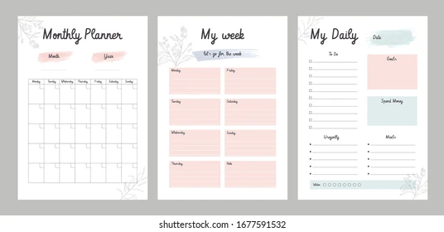
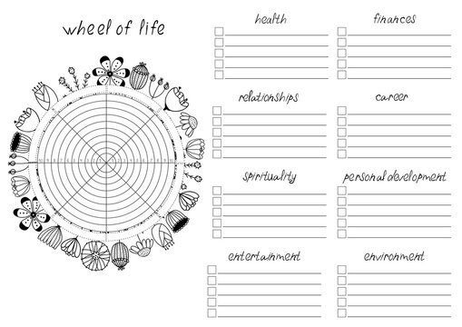


OUR SYSTEM
Our system is a E-commerce website from where people can buy printable products.
Some of the printable items that we are providing in our website:
Digital Planners(calenders,project planners,meal planners,financial planners)
Digital Trackers
Digital Journals
Digital Workbooks
Digital Stickers
Printable Bookmarks

Slide 7

FEATURES
Menu
Catalog Browsing
Category List
Product List
Catalog Management
Product Browsing
Product Reviews
Related Products
Shopping Cart
Account

Slide 8
LANGUAGES
HyperText Markup Language(HTML)
Cascading Style Sheets(CSS)
Bootstrap
PHP
MySQL

Slide 9
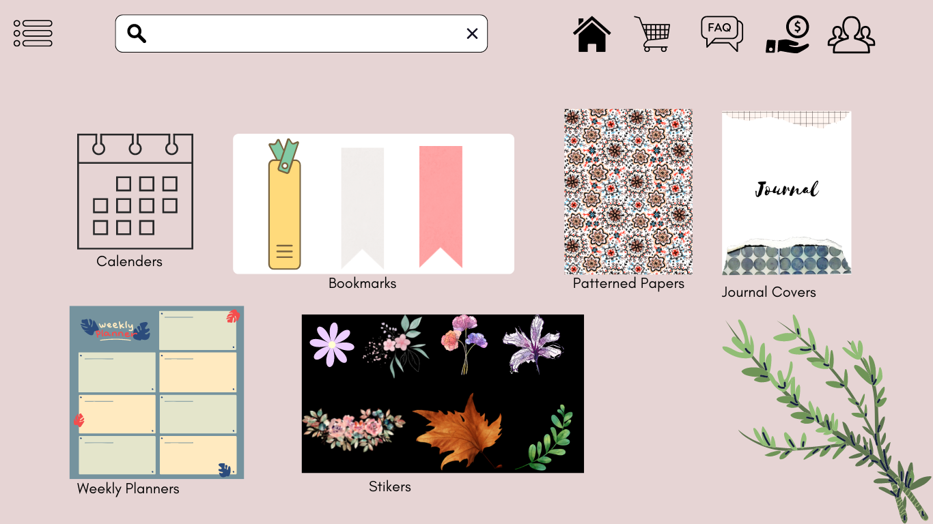
UI DIAGRAM

Slide 10
VALUE PROPOSITION
Our website is providing digitalised and printable products to the customers without them worrying about the shipping prices and delivery time.
We will be providing a FAQ section where people can ask us to customize a choosen product.
People can just download these templates in their phones, i-pads and laptops.

Slide 11
FUTURE ENHANCEMENT
Making a platform where freelancers can provide their own designs and show their creativity.
They can earn money .
We can create website and blogs design.

Slide 12
GROUP MEMBERS
AGRIMA MAHARANA
AMISHA PATRA
BANOTHU JAMUNA
DUVVAPU KOUSALYA
DEPARTMENT: CSE-A

Slide 13
THANK YOU

